Slide 1
Unicast Routing

Slide 2
Routing Protocols
the goal of the network layer is to deliver a datagram from its source to its destination or destinations
If a datagram is destined for only one destination (one-to-one delivery), we have unicast routing
If the datagram is destined for several destinations (one-to-many delivery), we have multicast routing

Slide 3
Unicast routing – Introduction
In unicast routing , a packet is routed, hop by hop, from its source to its destination by the help of forwarding tables
the networks in the internet need forwarding tables.

Slide 4
An Internet as a Graph
To find the best route, an internet can be modeled as a graph.
A graph is a set of nodes and edges (lines) that connect the nodes.
each router as a node and each network between a pair of routers as an edge.
Each edge is associated with a cost.

Slide 5
Least-Cost Routing
Best route from the source router to the destination router is to find the least cost between the two.
the source router chooses a route to the destination router - the total cost for the route is the least cost among all possible routes.

Slide 6
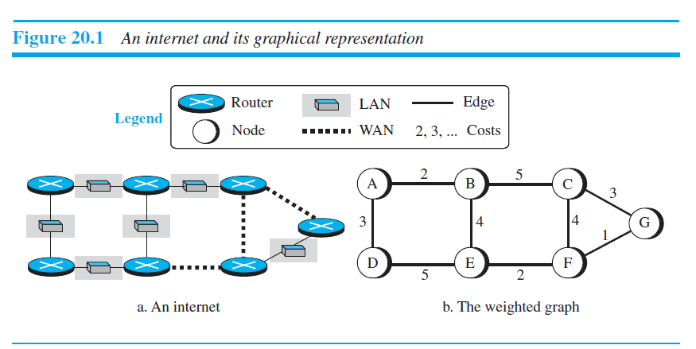

Slide 7
Least-Cost Trees
least-cost tree is a tree with the source router as the root that spans the whole graph (visits all other nodes) and in which the path between the root and any other node is the shortest.
shortest-path tree for each node

Slide 8
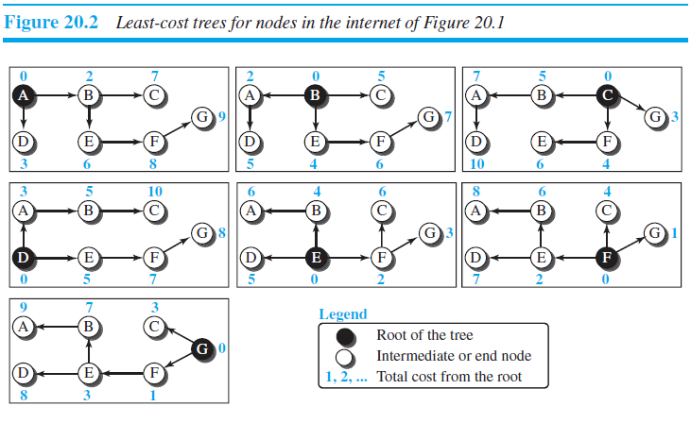

Slide 9
ROUTING ALGORITHMS
Distance-Vector Routing (or) Bellman-Ford Equation
Link-State Routing

Slide 10
Approaches to Shortest Path Routing
1. Link State Routing
Each node knows the distance to its neighbors
The distance information (=link state) is broadcast to all nodes in the network
Each node calculates the routing tables independently
2. Distance Vector Routing
Each node knows the distance (=cost) to its directly connected neighbors
A node sends a list to its neighbors with the current distances to all nodes
If all nodes update their distances, the routing tables eventually converge

Slide 11
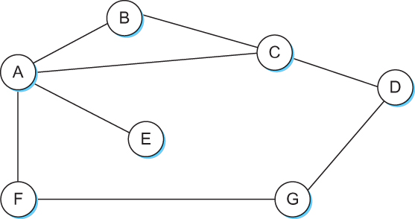
Distance Vector
Each node constructs a one dimensional array (a vector) containing the “distances” (costs) to all other nodes and distributes that vector to its immediate neighbors
Starting assumption is that each node knows the cost of the link to each of its directly connected neighbors

Slide 12
Distance-vector routing
the first each node creates is its own least-cost tree
The incomplete trees are exchanged between immediate neighbors to make the trees more and more complete and to represent the whole internet.
A router continuously tells all of its neighbors what it knows about the whole internet (although the knowledge can be incomplete)

Slide 13
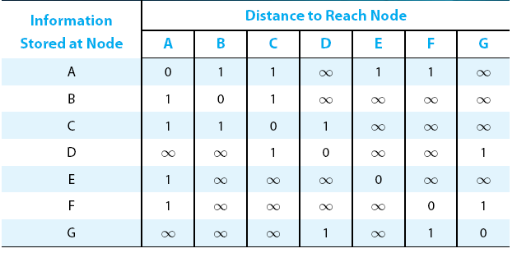
Distance Vector
Initial distances stored at each node (global view)

Slide 14
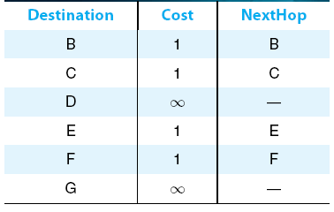
Distance Vector
Initial routing table at node A

Slide 15
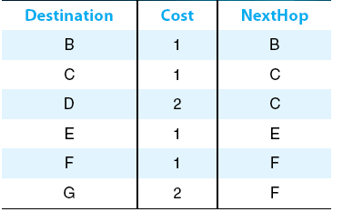
Distance Vector
Final routing table at node A

Slide 16
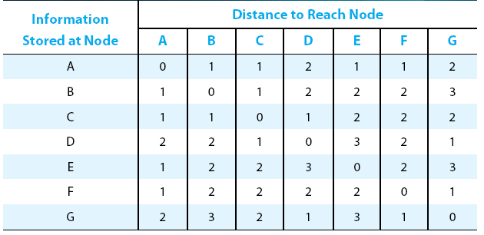
Distance Vector
Final distances stored at each node (global view)

Slide 17
Distance Vector
The distance vector routing algorithm is sometimes called as Bellman-Ford algorithm
Every T seconds each router sends its table to its neighbor each each router then updates its table based on the new information
Problems include fast response to good new and slow response to bad news. Also too many messages to update

Slide 18

Bellman-Ford Equation
This equation is used to find the least cost (shortest distance) between a source node, x, and a destination node, y
D_{ij} is the shortest distance and c_{ij} is the cost between nodes i and j.

Slide 19
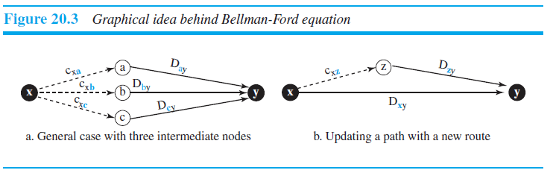

Slide 20
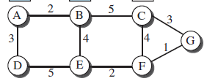
Illustrate the principle of distance vector routing and apply Bellman-Ford algorithm to find the shortest path tree for node A (or) to find routing table for given scenario

Slide 21
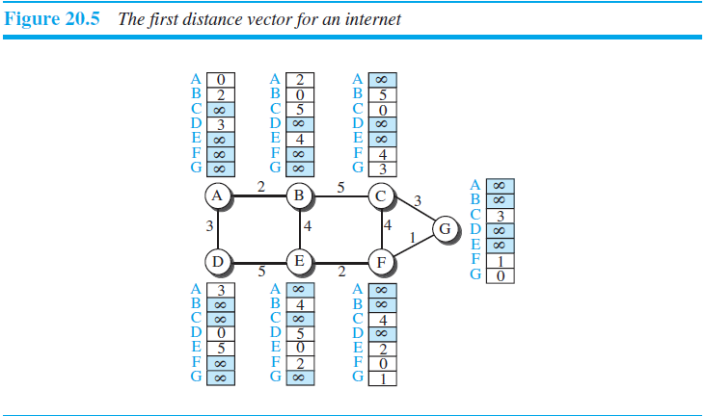

Slide 22
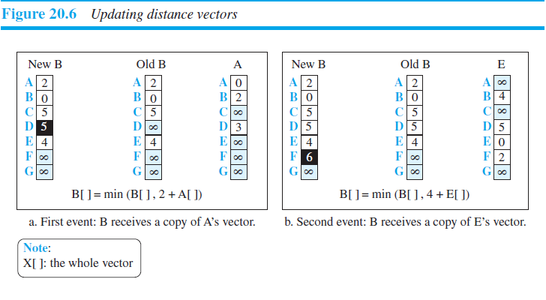

Slide 23
Characteristics of Distance Vector Routing
Periodic Updates: Updates to the routing tables are sent at the end of a certain time period. A typical value is 90 seconds.
Triggered Updates: If a metric changes on a link, a router immediately sends out an update without waiting for the end of the update period.
Full Routing Table Update: Most distance vector routing protocol send their neighbors the entire routing table (not only entries which change).
Route invalidation timers: Routing table entries are invalid if they are not refreshed. A typical value is to invalidate an entry if no update is received after 3-6 update periods.

Slide 24
The Count-to-Infinity Problem
A
1
B
1
C

Slide 25
Count-to-Infinity
The reason for the count-to-infinity problem is that each node only has a “next-hop-view”
For example, in the first step, A did not realize that its route (with cost 2) to C went through node B
How can the Count-to-Infinity problem be solved?

Slide 26
Count-to-Infinity
The reason for the count-to-infinity problem is that each node only has a “next-hop-view”
For example, in the first step, A did not realize that its route (with cost 2) to C went through node B
How can the Count-to-Infinity problem be solved?
Solution 1: Always advertise the entire path in an update message (Path vectors)
If routing tables are large, the routing messages require substantial bandwidth
BGP uses this solution

Slide 27
Count-to-Infinity
The reason for the count-to-infinity problem is that each node only has a “next-hop-view”
For example, in the first step, A did not realize that its route (with cost 2) to C went through node B
How can the Count-to-Infinity problem be solved?
Solution 2: Never advertise the cost to a neighbor if this neighbor is the next hop on the current path (Split Horizon)
Example: A would not send the first routing update to B, since B is the next hop on A’s current route to C
Split Horizon does not solve count-to-infinity in all cases!

Slide 28
Link State Routing

Slide 29
Link State Routing
Strategy: Send to all nodes (not just neighbors) information about directly connected links (not entire routing table).
Link State Packet (LSP)
id of the node that created the LSP
cost of link to each directly connected neighbor
sequence number (SEQNO)
time-to-live (TTL) for this packet
Reliable Flooding
store most recent LSP from each node
forward LSP to all nodes but one that sent it
generate new LSP periodically; increment SEQNO
start SEQNO at 0 when reboot
decrement TTL of each stored LSP; discard when TTL=0

Slide 30
Link State Routing
In link state routing, each node has a complete map of the topology
If a node fails, each node can calculate the new route
Difficulty: All nodes need to have a consistent view of the network
A
B
C
A
B
C
A
B
C
D
E
F
D
E
F
D
E
F
A
B
C
D
E
F
A
B
C
A
B
C
A
B
C
D
E
F
D
E
F
D
E
F

Slide 31
Link State Routing
Each node must
discover its neighbors
measure the delay (=cost) to its neighbors
broadcast a packet with this information to all other nodes
compute the shortest paths to every other router
The broadcast can be accomplished by flooding
The shortest paths can be computer with Dijkstra’s algorithm

Slide 32
Link State Routing: Basic princples
1. Each router establishes a relationship (“adjacency”) with its neighbors
2.Each router generates link state advertisements (LSAs) which are distributed to all routers
LSA = (link id, state of the link, cost, neighbors of the link)
3. Each router maintains a database of all received LSAs (topological database or link state database), which describes the network has a graph with weighted edges
4. Each router uses its link state database to run a shortest path algorithm (Dijikstra’s algorithm) to produce the shortest path to each network

Slide 33
Link State Routing: Properties
Each node requires complete topology information
Link state information must be flooded to all nodes
Guaranteed to converge

Slide 34
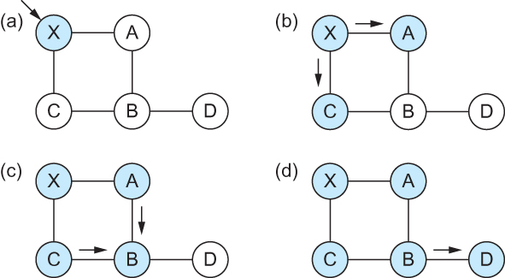
Link State
Reliable Flooding
Flooding of link-state packets. (a) LSP arrives at node X; (b) X floods LSP to A and C; (c) A and C flood LSP to B (but not X); (d) flooding is complete

Slide 35
Dijkstra’s Shortest Path Algorithm for a Graph
Input: Graph (N,E) with N the set of nodes and E ⊆ N × N the set of edges
d_{vw} link cost (d_{vw} = infinity if (v,w) ∉ E, d_{vv} = 0)
s source node.
Output: D_{n} cost of the least-cost path from node s to node n
M = {s};
for each n ∉ M
D_{n} = d_{sn};
while (M ≠ all nodes) do
Find w ∉ M for which D_{w} = min{D_{j} ; j ∉ M};
Add w to M;
for each n ∉ M
D_{n} = min_{w} [ D_{n}, D_{w} + d_{wn} ];
Update route;
enddo

Slide 36
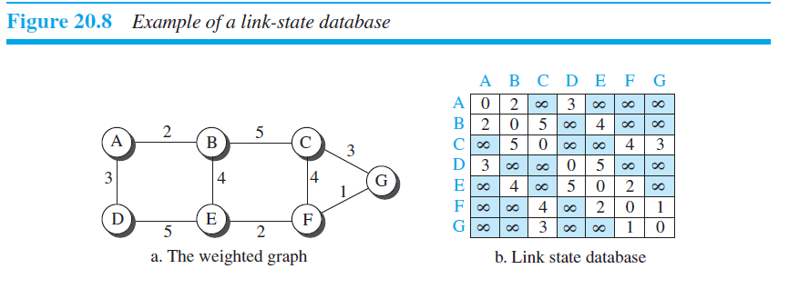

Slide 37
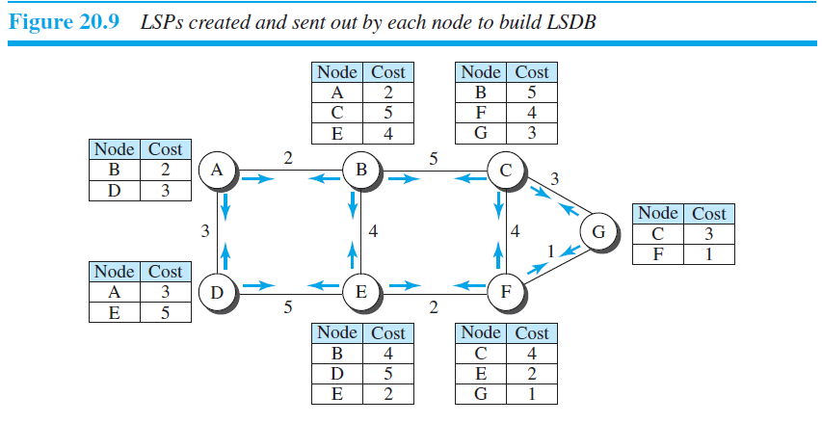

Slide 38
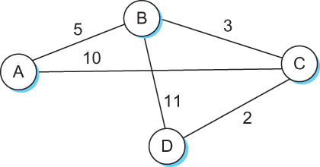
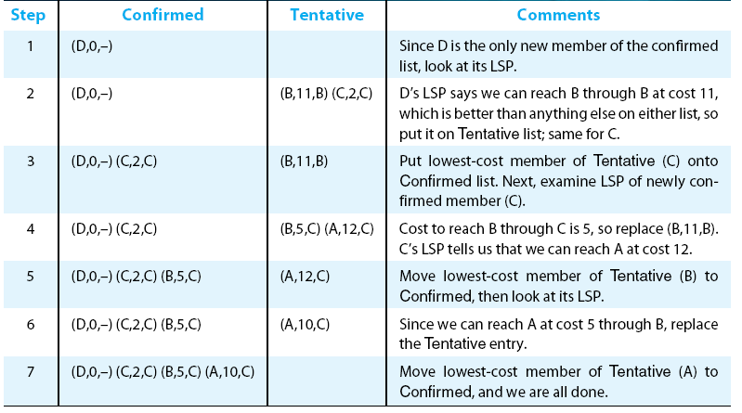
Shortest Path Routing

Slide 39
Example Network
5
2
3
3
5
2
1
2
1
6
3
1
4
5
2
1

